Slide 1
Challenges of Data Collection for a Fully Remote Clinical Trial with a Multi-Component Outcome: Virtual ELM Pilot Study
Kelly Karavolos, MA
Tamara Olinger, MS
Brian Neumann, BS
Rebecca Dawar, MPH
Sumihiro Suzuki, PhD
Lynda H. Powell, PhD
Data Management Center
Department of Preventive Medicine
Rush University Medical Center, Chicago IL

Slide 2
Disclosure
No actual or potential conflict of interest or financial disclosures.

Slide 3
Background
Growing interest in remote clinical trials
Convenience, improved recruitment, retention, engagement
Increased accessibility to remote healthcare
Remote data collection and intervention delivery made easier
Ongoing, in-person, national, multi-site clinical trial
Objective
Feasibility of remote data collection and delivery of a existing, in-person lifestyle intervention to participants with the Metabolic Syndrome

Slide 4
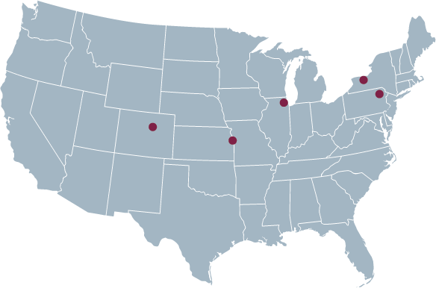
ELM Multi-site Trial
www.elmtrial.org

Slide 5
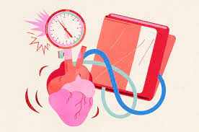
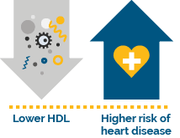
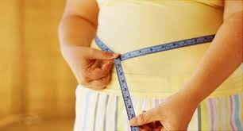
Metabolic Syndrome (MetS)
Presence of at least 3 of the following risk factors:
Blood Pressure > 130/85 mm Hg
Triglycerides > 150 mg/dL
Glucose between 100 -125 mg/dL
HDL Cholesterol <40 mg/dL (men) and <50 mg/dL (women)
Waist > 40 in (men) and > 35 in (women)
Notes:
I would take out the pictures.

Slide 6
Virtual ELM Primary Outcome: 5% Weight Loss

Slide 7
Remote Data Collection Methods
Participant recruitment via self-referral or medical records interrogation
Fully remote outcomes data collection - baseline and 3-month follow-up
Mailed equipment with instructions on how to use it
Research staff Zoom sessions with participants for physical measures data collection
Participant visits to lab to conduct blood draw
Group-based intervention Zoom sessions
Participant logs

Slide 8
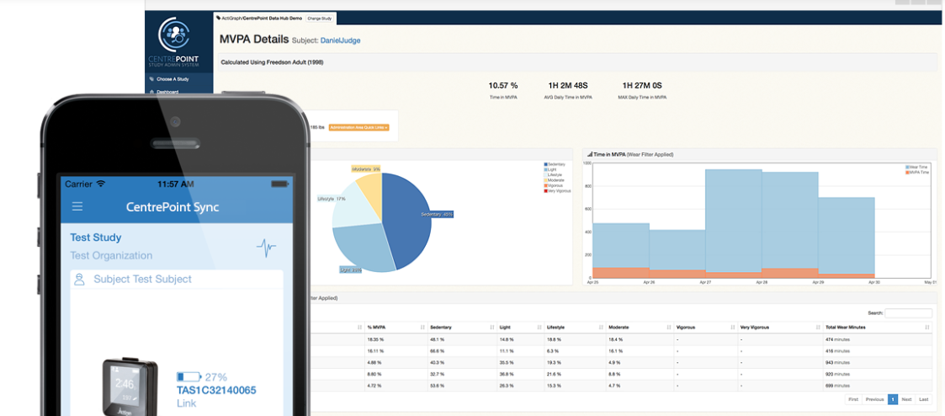
Remote Data Collection Methods (cont’d)
Cloud-based platforms
Snap Surveys (web-based questionnaires)
www.snapsurveys.com
Actigraph/CentrePoint
www.actigraphcorp.com/centrepoint/

Slide 9
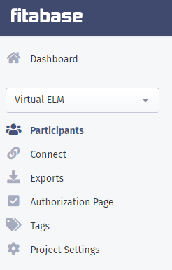
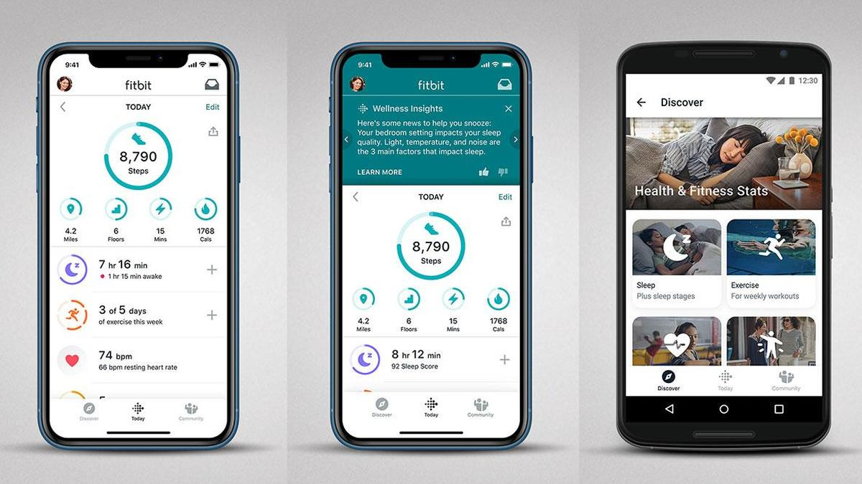
Remote Data Collection Methods (cont’d)
Cloud-based platforms
Fitabase (weight, steps, and food logs)
www.fitabase.com
Blood Draw
Quest Diagnostics (glucose, HDL, triglycerides)
www.questdiagnostics.com

Slide 10
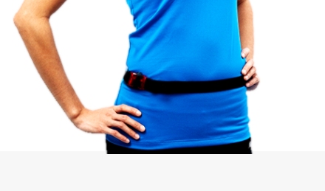
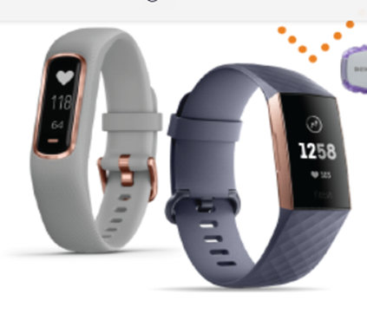
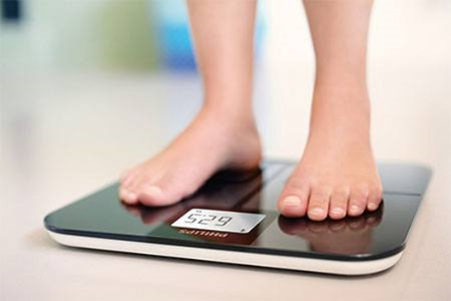
Remote Data Collection Methods (cont’d)
Devices
Accelerometers (physical activity minutes)
Blood pressure monitors (blood pressure)
Fitbit activity trackers/Fitbit app
Wireless scales (weight)
Waist measuring tapes (waist)

Slide 11
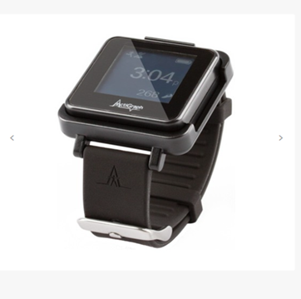
Remote Data Collection Challenges
Participant smart phone technology awareness
Participant uptake and accessibility to smart phone technology (age, SES)
Physical measures accuracy
Completion of blood draws
Completion of the accelerometer protocol
Resourceful delivery of remote intervention

Slide 12
Remote Data Collection Successes
Pilot achieved 100% retention for follow-up outcomes assessments.
Virtual ELM: Session Attendance, N=10
% Attendance (virtual), mean (sd) | 94.9 (7.2)
Attendance ≥ 80%, N (%) | 10 (100)
Four out of 10 participants achieved 5% weight loss.
Change in Outcomes, N=10
 | Baseline | Follow-up
Primary Outcome
Weight Loss ≥ 5%, N (%) | - | 4 (40)
% Change in weight, mean (sd) | - | -3.7 (2.9)
Secondary Outcomes
Weight (kg), mean (sd) | 95.6 (15.4) | 92.3 (16.8)
Waist circumference (cm), mean (sd) | 107.6 (6.1) | 103.5 (6.4)

Slide 13
Conclusion
Promising results for the possibility of efficient execution of a remote, large-scale trial
Proactively addressing challenges in the enrollment phase
Refinement in the planning phase, e.g. selecting effective data capture tools

Slide 14
Disclosure
No actual or potential conflict of interest or financial disclosures.

Slide 15
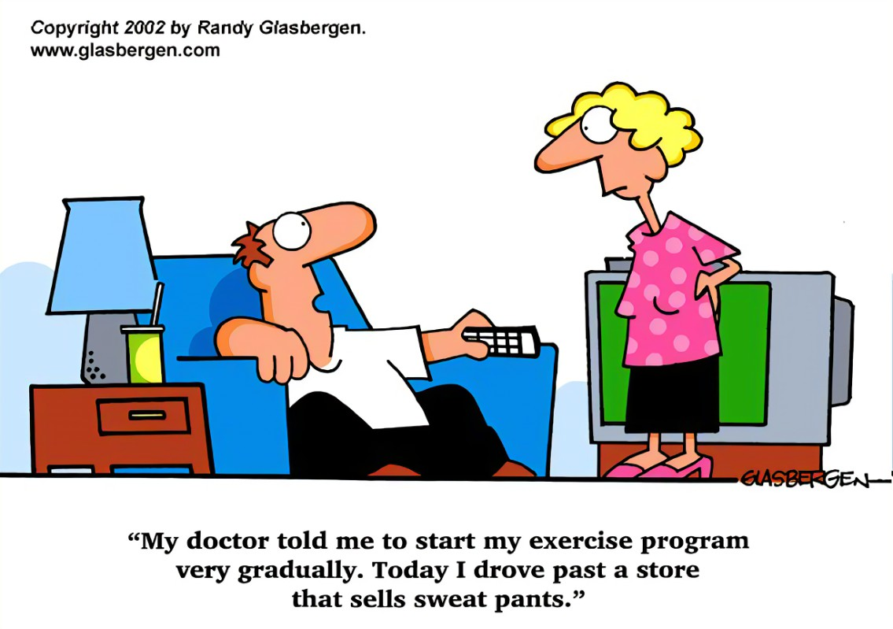
Questions? Thank you!

